Slide 1

Data Structures
Lecture 3: Vectors

Slide 2

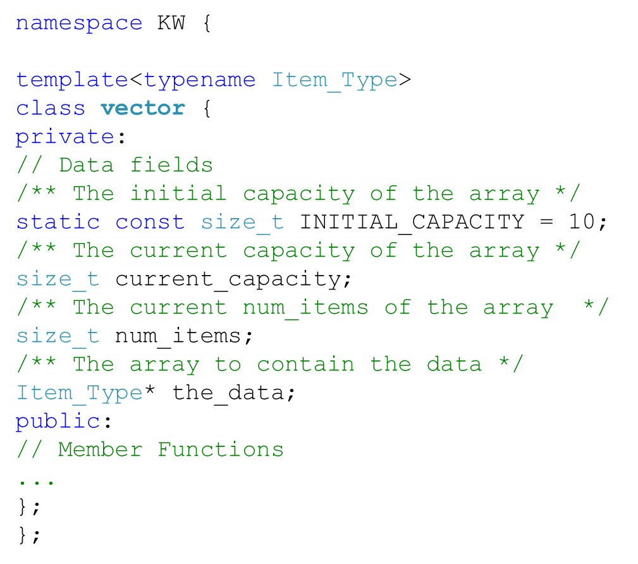
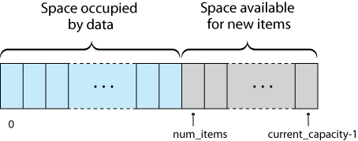
Implementation of a vector class
  Physical size of array indicated by data field current_capacity
  Number of data items indicated by the data field num_items
Notes:
The difference between vectors and arrays: vectors are resizable and you can insert/erase items from the middle of the vector.

Slide 3
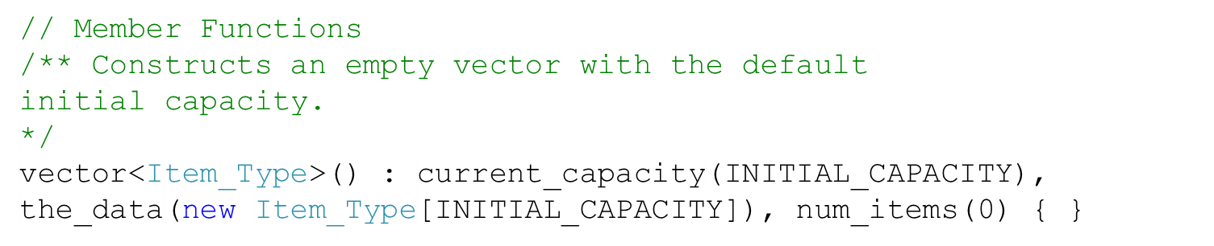
The Default Constructor

Slide 4

Functions of vector class
Function | Behavior
 | Accesses an item at a given index.
 | Does as the above, but doesn’t allow the user to change the contents of the vector.
 | Inserts an item (the_value) at a given index.
 | Erases an item at a given index.
 | Appends an item to the end of the vector.

Slide 5
Accessing Items in Vectors ( [] vs. at )
In standard vectors (provided by C++ std::vector) there are two ways to access item: the subscript operator ( [] ) and at.
[] doesn’t perform range checking, leaving door open for problems. (In the new compiler of vectors, it actually performs range checking).
at raises an out-of-range exception if the user tries to access an item that is out of the vector boundaries.

Slide 6
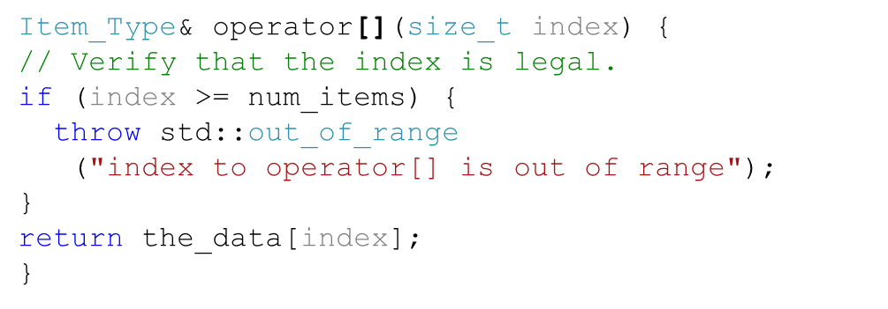
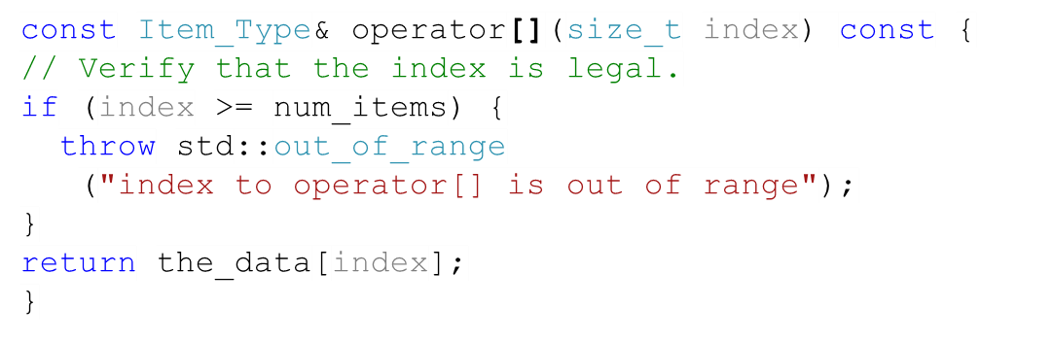
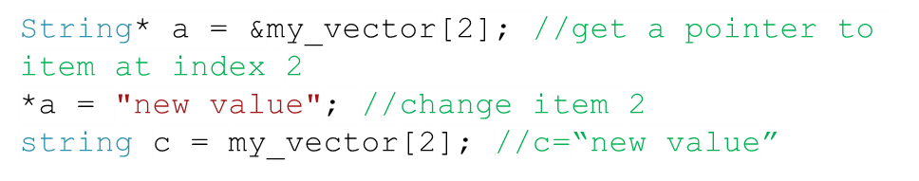
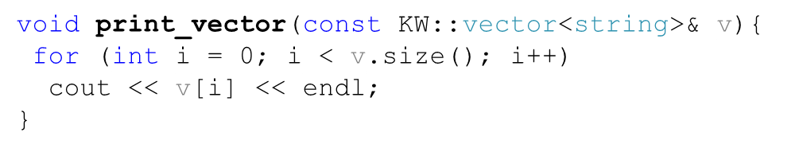
The Subscripting Operator ( [] )
The first const tells the compiler that the return value is a constant reference to an Item_Type.
The compiler invokes this version when we intend to change the contents of the vector.
The second const tells the compiler not to change the value of the vector object.
This version is called when we intend to only read the contents of the vector

Slide 7
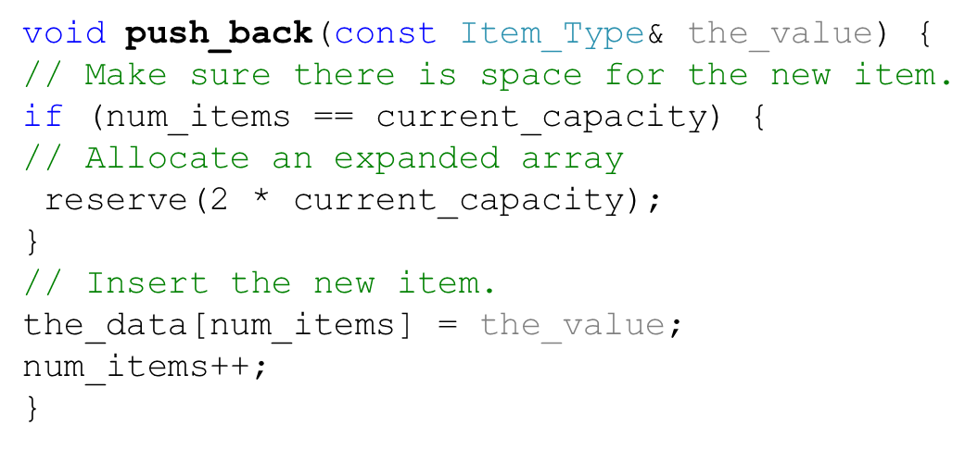



The push_back Function
num_items (8)
num_items (11)
num_items (10)
num_items (9)
A
B
C
D
E
F
G
H
I
J
K
current_capacity (10)
current_capacity (20)

Slide 8
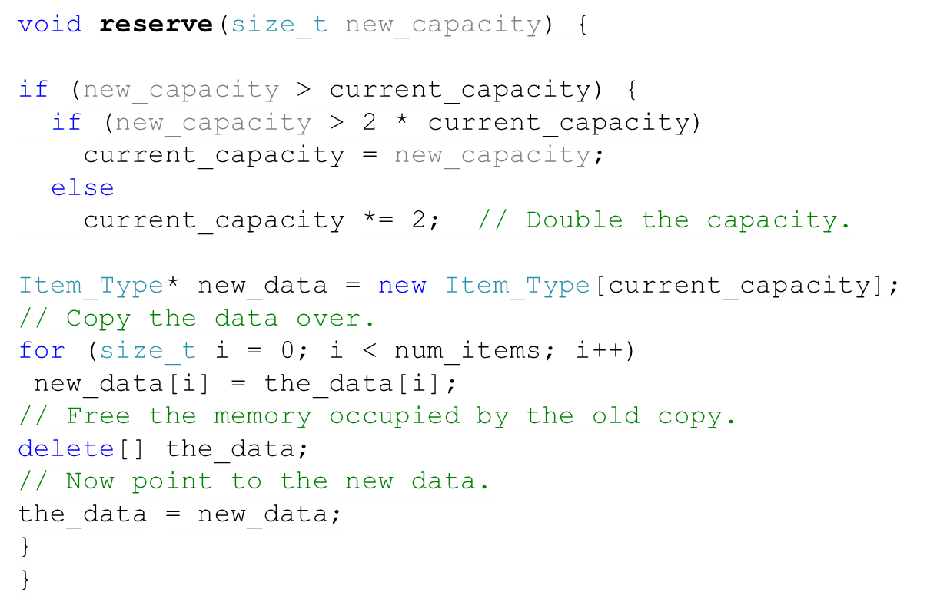
The reserve Function
the_data
the_data
new_data

Slide 9
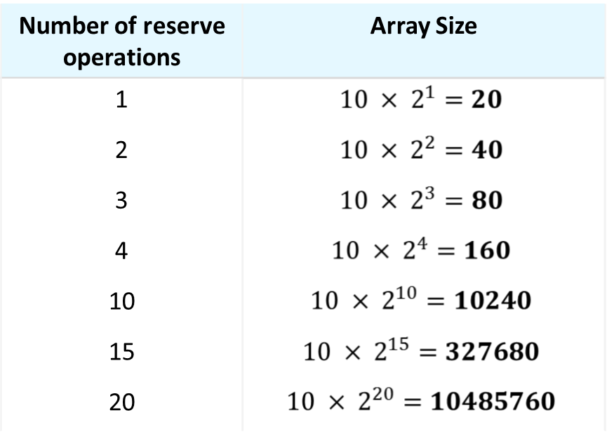
Why Reserve Doubles the Size
Spread out the cost of copying.
Each reallocation costs O(n)
We do the reallocation after adding n items, so on average, we need a copy for each item.
Effectively reallocation is O(1)

Slide 10
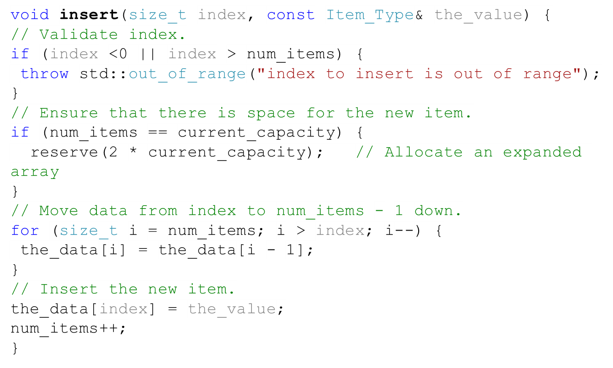
The insert Function
[0] [1] [2] [3] [4] [5] [6] [7] [8] [9]
A
B
C
D
X
Y
Z
X
Y
Z
M
When shifting to the left, why do we start from the end of the vector?
[0] [1] [2] [3] [4] [5] [6] [7] [8] [9]
A
B
C
D
X
X
Y
X
X
Z
X
X
M
If we start from the location of the to-be-inserted item, the items after the to-be-inserted will be overwritten.
Notes:
Ask the students about the performance of this function

Slide 11
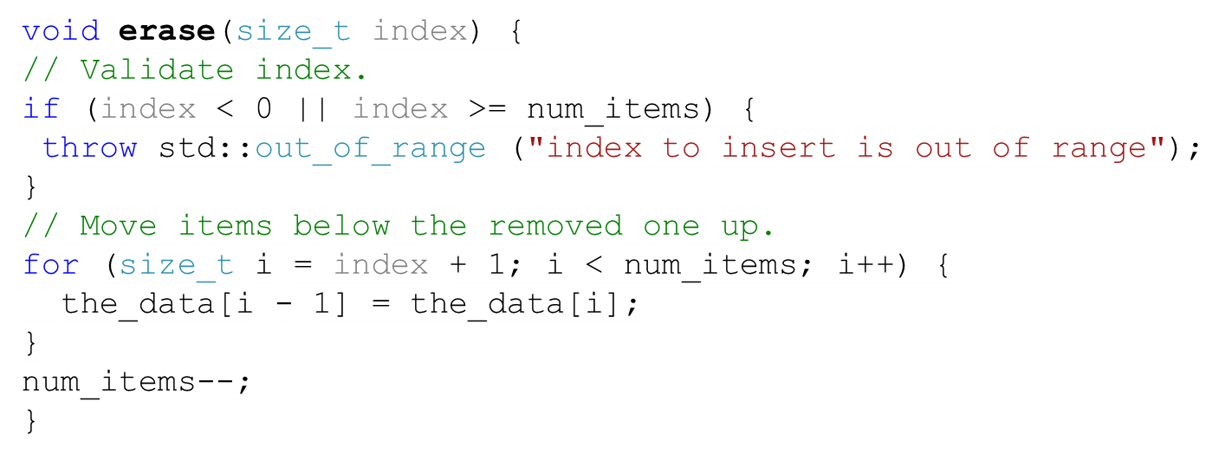
The erase Function
[0] [1] [2] [3] [4] [5] [6] [7] [8] [9]
A
B
C
D
X
Y
Z
Y
Z
num_items (7)
num_items (6)
When shifting to the left, why do we start from to-be-deleted item?
[0] [1] [2] [3] [4] [5] [6] [7] [8] [9]
A
B
C
D
X
Y
Z
Z
Z
If we start from the end of the vectors, the items after the to-be-deleted item will be overwritten.
Notes:
Ask the students about the performance of this function

Slide 12


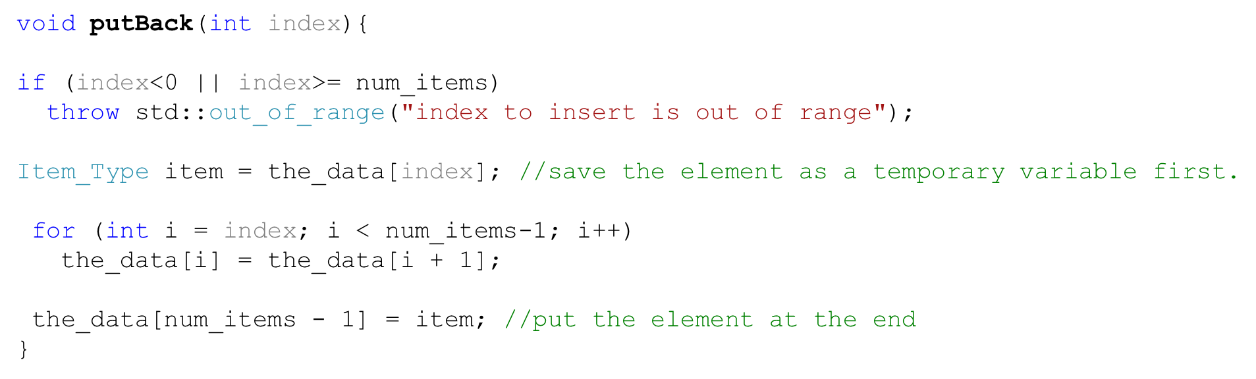
Task
Write a function to remove an element of a given index from a vector and place it at the end (the final vector shouldn’t have a gap).

Slide 13
The Copy Constructor
Both the original and the copy will initially store the same information.
The copy should be independent. Modifying the copy or the origin doesn’t affect the other.
Every class has a copy constructor with the following signature:
class-name(const class-name&);
vector<int> v2(v1);
The copy constructor is automatically invoked when:
1. An object is passed to a function by value.
2. An object is returned from a function.
3. An object is initialized with another object of the same class.

Slide 14
The Default Copy Constructor
The default copy constructor makes a copy of each field’s value.
vector<int> v2(v1);
This is fine for primitive fields (e.g. current_capacity, num_items).
v1[2] = 10;
For non-primitive fields (e.g. arrays), a shallow copy is created.
v1.push_back(20);
kw::vector<int> v1
num_items = 5
current_capacity = 10
int* the_data =
6
[0] [1] [2] [3] [4] [5] [6] [7] [8] [9]
1
2
10
20
3
4
5
kw::vector<int> v2
num_items = 5
current_capacity = 10
int* the_data =

Slide 15
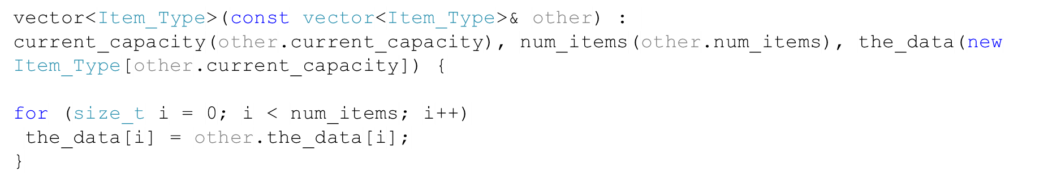
Deep Copy of a Vector
kw::vector<int> v1
num_items = 5
current_capacity = 10
int* the_data =
[0] [1] [2] [3] [4] [5] [6] [7] [8] [9]
1
2
3
4
5
kw::vector<int> v2
num_items = 5
current_capacity = 10
int* the_data =
[0] [1] [2] [3] [4] [5] [6] [7] [8] [9]
1
2
3
4
5

Slide 16
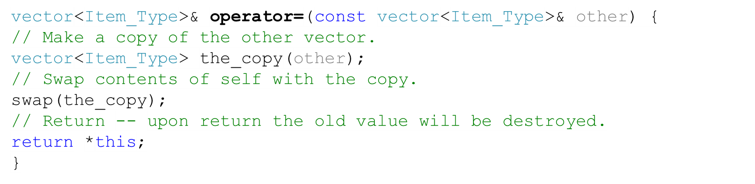
Assignment Operator
The purpose of an assignment is also to create an independent copy of an object.
v2 = v1 is executed as if it were written v2.operator=(v1)
Every class has a default assignment operator, but it makes a shallow copy of an object, so we must override it if we want an independent copy.

Slide 17
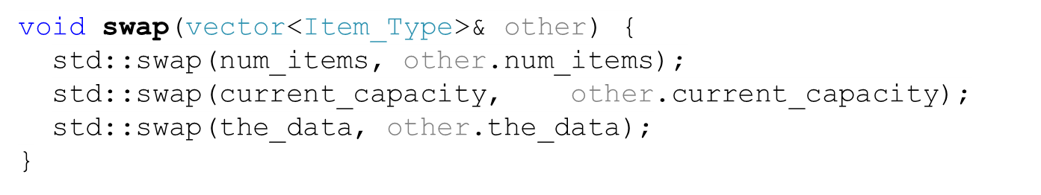
swap

Slide 18
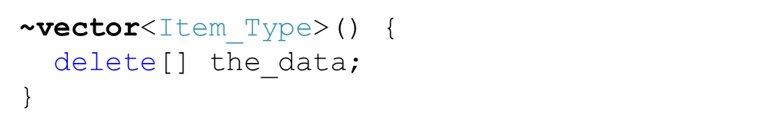
The Destructor
The destructor undoes what the constructor does.
The destructor invalidates the object, and allows the memory it occupies to be reused.
If your object refers to a dynamically allocated object (e.g. array), the memory allocated to that object must be freed.
When is a destructor called?
When the object in a function goes out of scope.
When you explicitly delete it.
Stack unwinding: when an exception is thrown.

Slide 19
Performance of the vector Class
Index operator executes in constant time: O(1)
Inserting or removing general elements is linear time: O(n)
Adding an element at the end (pushing it back) is O(1) on average, but O(n) in the worst case.
Inserting or removing an element (in the middle of a vector ) is O(n).

Slide 20
Rule of Three
Assignment, copy constructor, and destructor have to be defined together for a class that dynamically allocates memory.
They should work together consistently.

Slide 21

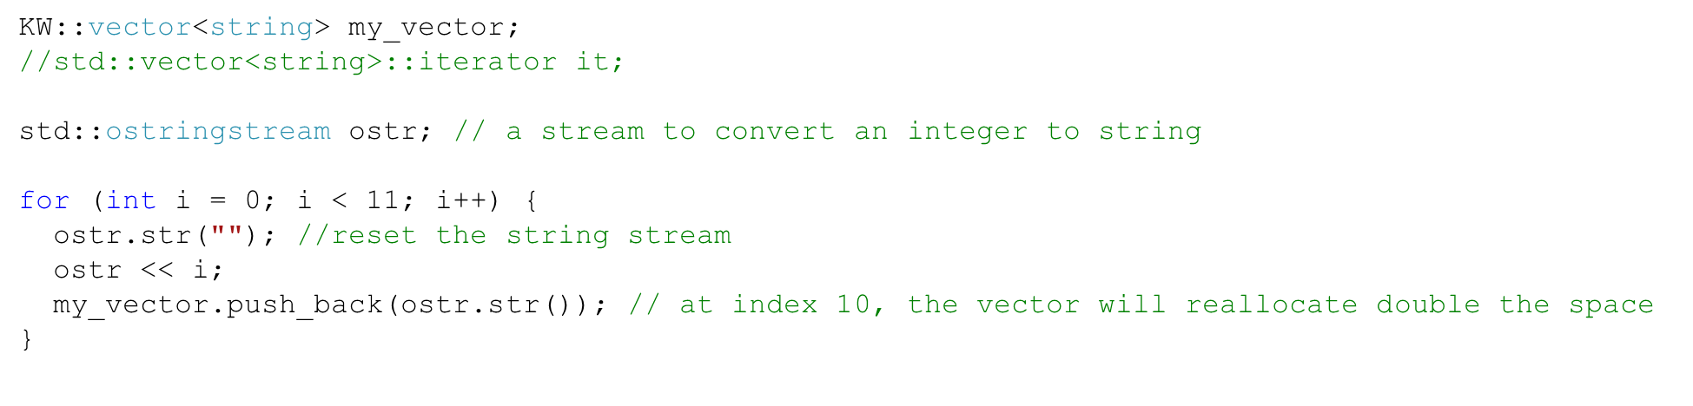
Demo of Using Vectors

Slide 22

Phone Directory
An application that stores employee’s information (including their phone numbers) in a vector
The application allows inserting, editing, deleting new employee entries.
1
Vector<Employee>
*
Employee
1
1
name: string
phone_number: string
room_number: string
job_description: string
Phone_Directory
User_Interface
+ load_data(): void
+ lookup_entry(name: String): Employee
+ add_entry(new_Employee: Employee): void
+ change_entry(new_Employee: Employee): void
. . .
+ process_commands()
+ do_add_entry()
+change_name()
+change_job_description()
+do_lookup_entry()
. . .
+ get_name(): string
+ get_number(): string
+ set_number(): void
. . .
1
1

Slide 23
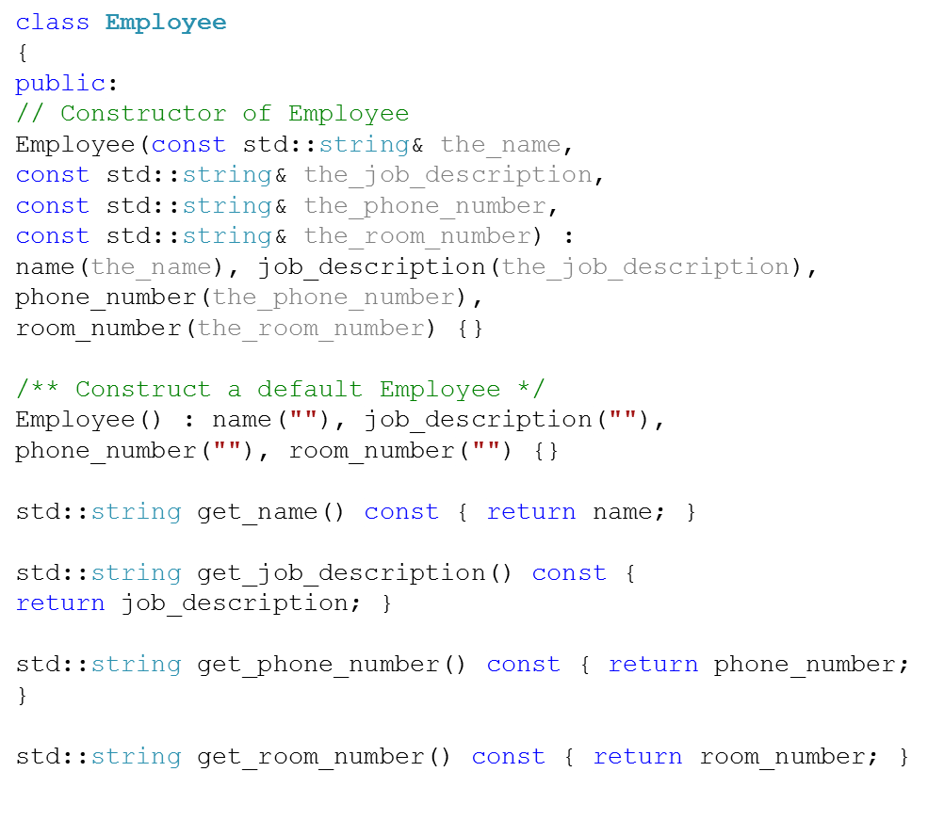
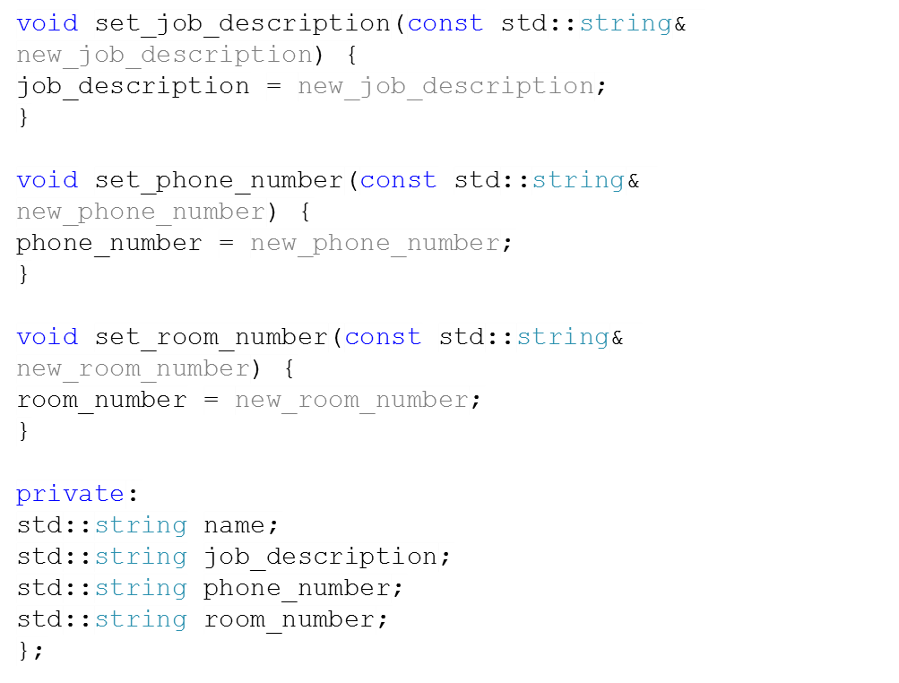
Employee class

Slide 24
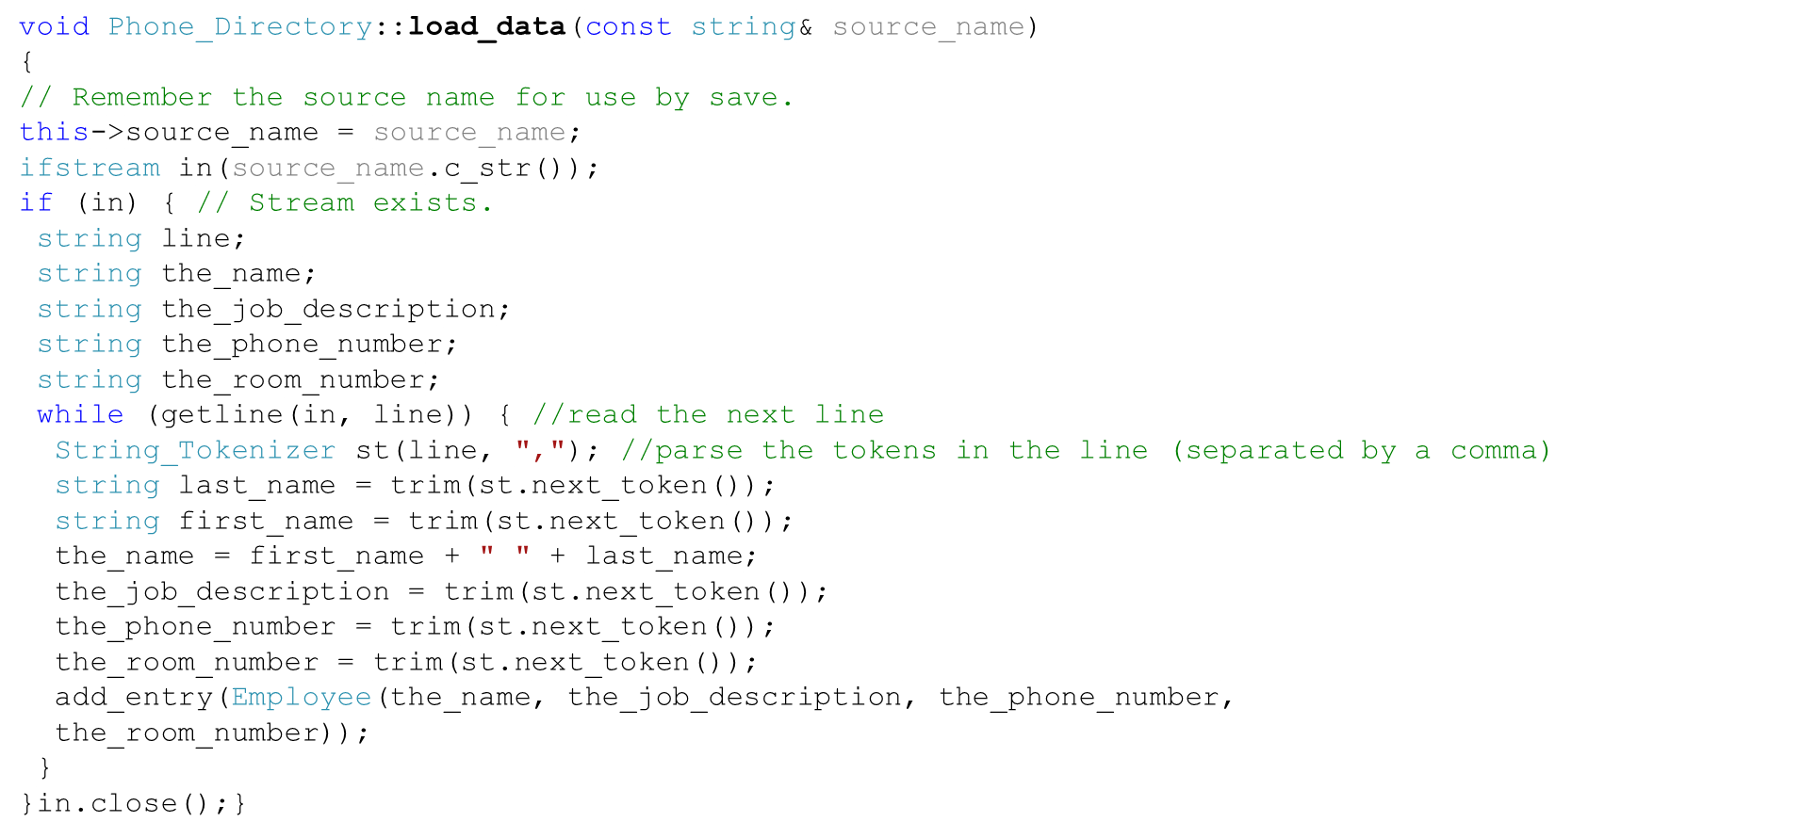
Functions of Phone_Directory (1)
King,Philip,Engineer,214-412-4121,1
Kepley,Kayla,Engineer,222-222-2222,2
. . .

Slide 25
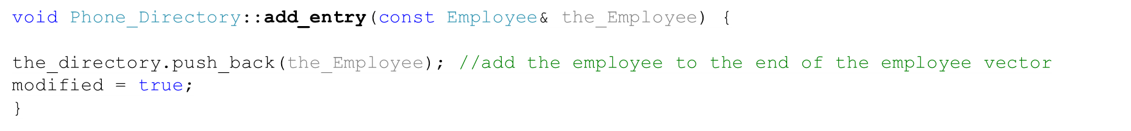
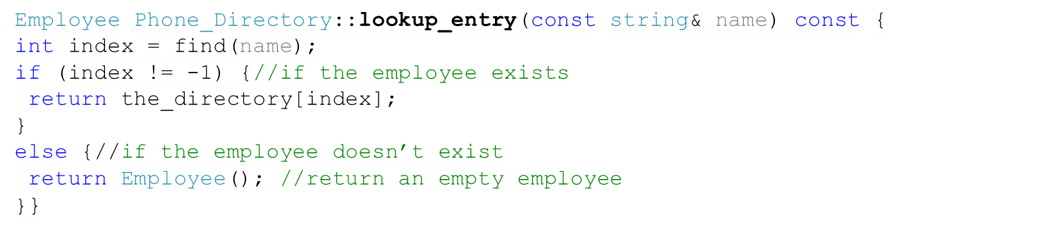
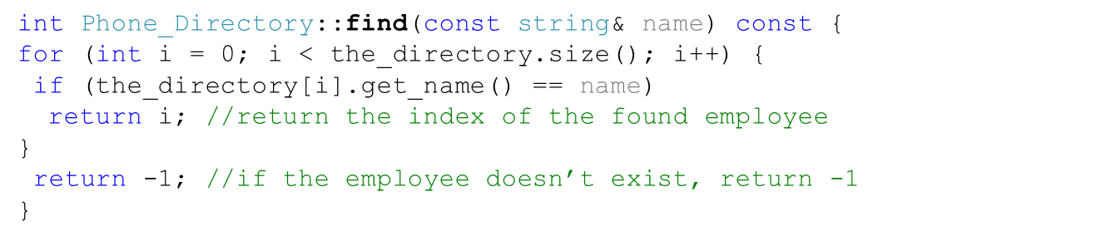
Functions of Phone_Directory (2)

Slide 26
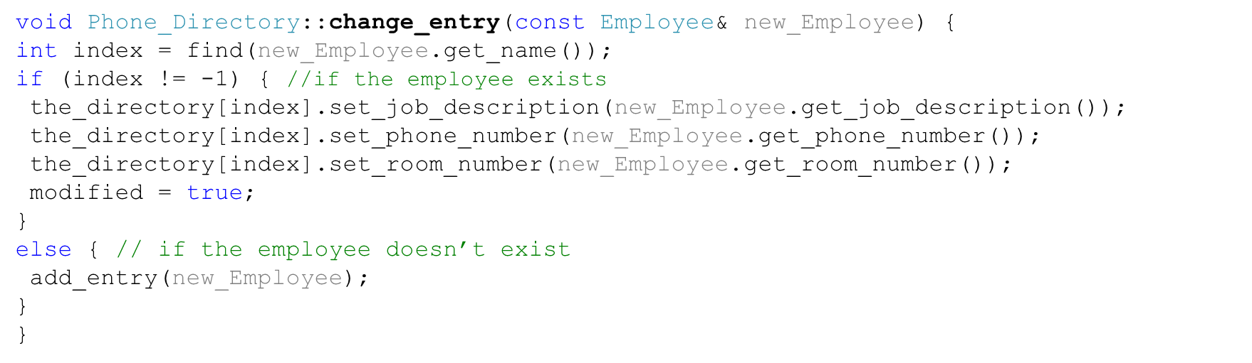
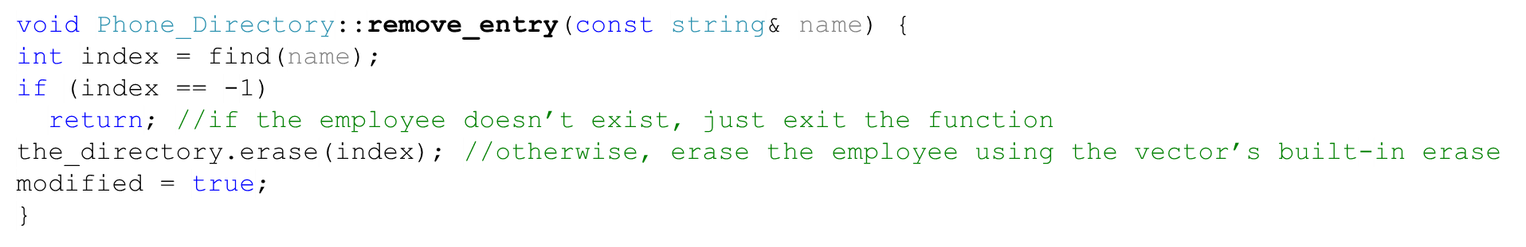
Functions of Phone_Directory (3)

